Slide 1

Capstone 3
Natural Language Processing with Book Summaries
Thomas Garabedian

Slide 2

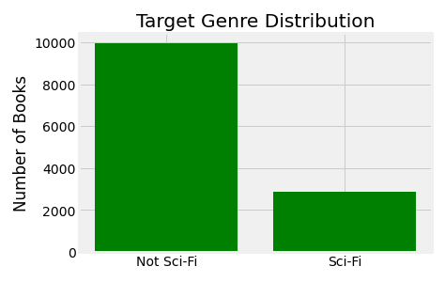
CMU Book Summary Dataset
Summaries are extracted from Wikipedia along with metadata including author, title, and genre.
Dataset contains 12841 total entries
Average entry length is 458 words
Genre Target is Sci-fi
Roughly 22.5% of entries are Sci-fi

Slide 3
Model Choice
RandomForestClassifier from sklearn
  Uses averaging to improve predictive accuracy
Used a TF-IDF vectorizer
  Term Frequency * Inverse Document Frequency
    Scales down impact of very frequent tokens

Slide 4
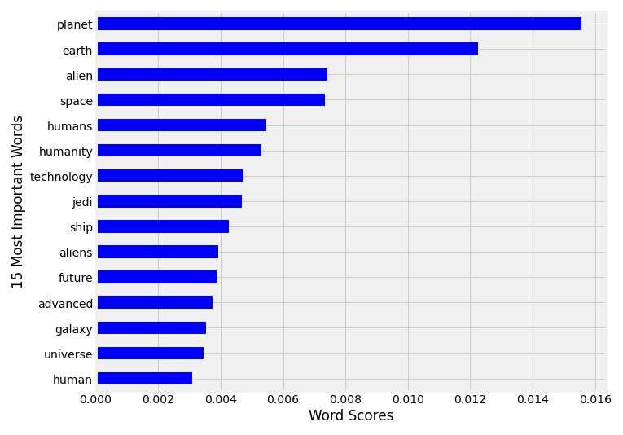
Initial Results
Test Accuracy = 84%
Most Important Words

Slide 5
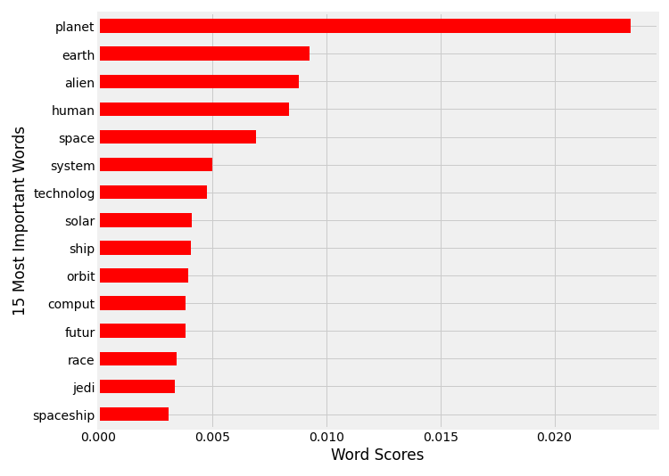
Initial Results
Test Accuracy = 84%
Most Important Words
Follow-up Stemming:
    SnowballStemmer – mid range
    aggressive stemming
Test Accuracy = 85.5%
Most Important Words

Slide 6
Parameter Tuning
Improved Stopwords:
  use, father, discover, three, third, one, two, late, confront, number, find, kill, take, also, people, begin, thing, first, planet
  Chosen because overweight and skew results, and nonsense that dilutes the pool
N-Grams:
  Added Bi-Grams to the tokenized corpus but removed it because of major drop offs in accuracy

Slide 7
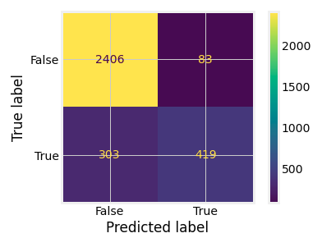
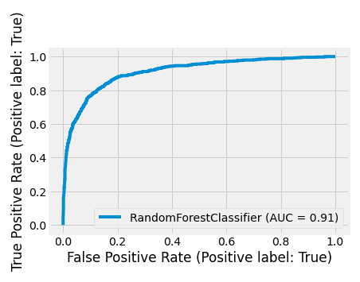
Parameter Tuning Effects
Confusion Matrix
  Recall = 14.8%
  Precision = 83.4%
Roc Curve
  Area under curve (AUC)

Slide 8
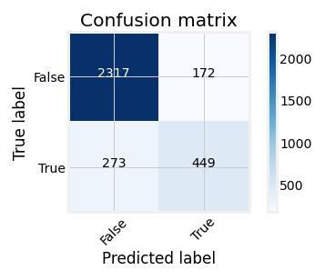
Parameter Tuning
Threshold Tuning
  The AUC provides a range of acceptance for the model parameters. I increased it for a more accepting predictor.
  Final threshold = .55
  Recall = 16.9%
  Precision = 75.1%

Slide 9
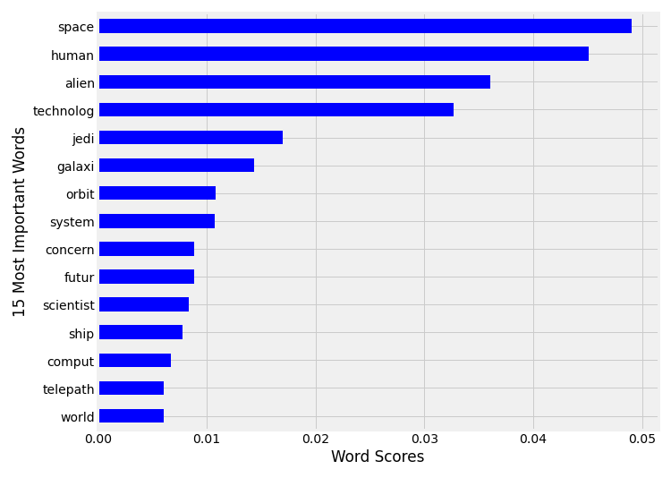
Final Thoughts
Final accuracy = 87.7%
Future Improvements:
  Continued stopwords improvement
  Redo Bi-grams, but include extensive stopword list

Slide 10







Thank you
Linkedin:
  www.linkedin.com/in/thomas-garabedian-809babb9
Email:
  thomas.garabed@gmail.com
Github:
  https://github.com/gr8willi35

